Slide 1
Web fundamentals project
How does the web works?
What do you need to be a web developer?
What’s the role of a web developer.
Presented by:
Nermine Bouabdallah

Slide 2
How does the web works?
Web development is the building and maintenance of websites.
The Web(World Wide Web) is a body of information stored on web servers.
Web tools are:
Clients which are the typical web user's internet-connected devices and web-accessing software available on those devices (usually a web browser).
Servers which are computers that store webpages, sites, or apps. When a client device wants to access a webpage, a copy of the webpage is downloaded from the server onto the client machine to be displayed in the user's web browser.

Slide 3
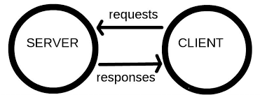
The moment you enter the required address in your browser :
The browser sends an HTTP request message to the server, asking it to send a copy of the website to the client.
This message, and all other data sent between the client and the server, is sent across your internet connection using TCP/IP.

Slide 4
What do you need to be a web developer?
Front-end developers focus on programming languages (HTML, CSS and JavaScript) to create the interactive and visual parts of a website, which is everything you can see on a site.
Back-end developers have to update and make changes, in addition to monitoring the functionality of the overall site(using MySQL,PHP..). Back-end development refers to the server-side.

Slide 5
What’s the role of a web developer.
A web developer is responsible for:
programming the code that “tells” a website how to function.
builds a website from the bottom up, which means designing it in such a way that end users have no difficulty navigating the site.

